Slide 1

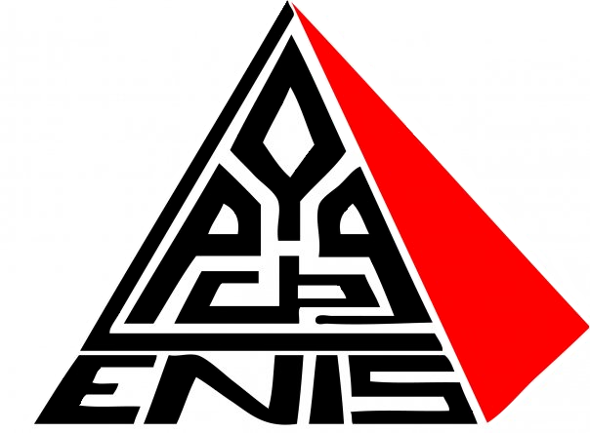
2022-2023
Development of a ”Fuzz testing” tool for automatic generation of test data for Ethereum smart contracts.
Mohamed Ali Mnassar Mohamed Ben Rhouma Racem Mrabet
Mr Tarek Frikha
Mrs Mouna Baklouti
Mrs Mariem Lahami
PROJET DE FIN D’ANNÉE
DEVELOPED BY
PRESIDENT
EXAMINATOR
SUPERVISOR
Notes:
Ladies and gentlemen, Today, I have the privilege of introducing three exceptional individuals who have joined forces to present an exciting topic at hand.
Together, they have embarked on a journey to develop a groundbreaking tool in the world of Ethereum smart contracts. Ouu project named leokai
and dedicated of fuzz Testing tool for the automatic generation of test data for etherieul smart contract

Slide 2
AGENDA
I
V
Context and Motivations
Architecture Design
II
VI
Problematic
Conceptual Diagrams
III
VII
Related Work
Technology Used
IV
VIII
Proposed Solution
Demo

Slide 3
Context/Motivations
01
Notes:
Time manipulation: If the smart contract relies on time-based conditions, an attacker may attempt to manipulate the contract by exploiting inconsistencies or vulnerabilities related to timekeeping. They could potentially extend or shorten campaign durations, manipulate deadlines, or exploit time-dependent conditions for their own advantage.

Slide 4
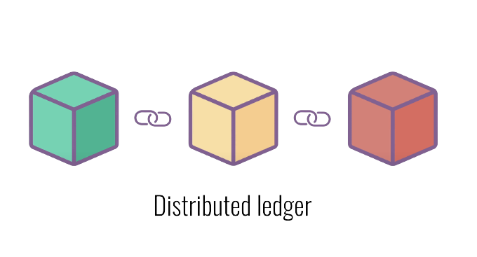
01
Context and Motivations
What is Blockchain?
Notes:
Blockchain is A distributed ledger that is open to anyone. They have an interesting feature. Once some data has been saved inside the blockchain, it becomes very difficult to change it.
A distributed ledger is a decentralized and transparent system for recording and verifying transactions or information across multiple computers or nodes. It uses cryptographic techniques to ensure security and consensus among participants, allowing them to maintain a synchronized and immutable record of data without the need for a central authority.

Slide 5
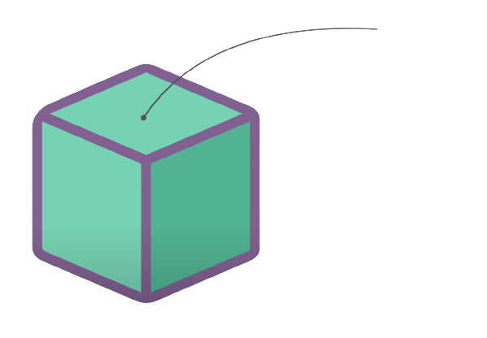
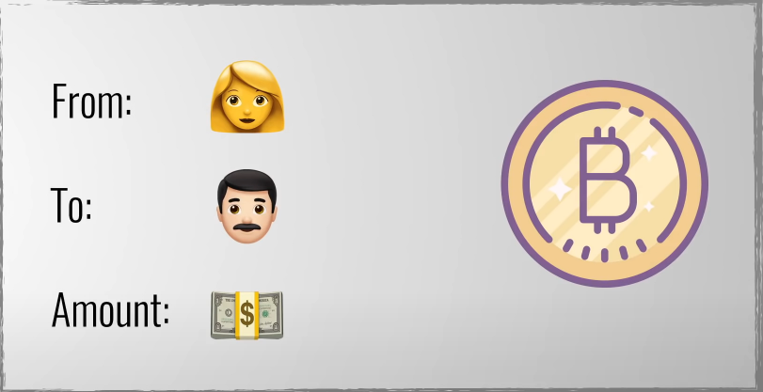
01
What is Blockchain?
Context and Motivations
Data
Bitcoin Block Example

Slide 6
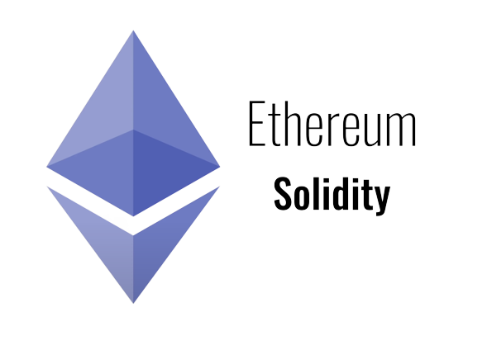

01
Context and Motivations
Ethereum
& Smart Contracts
Data
Smart Contract
Ethereum
Block
Example

Slide 7
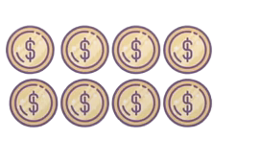
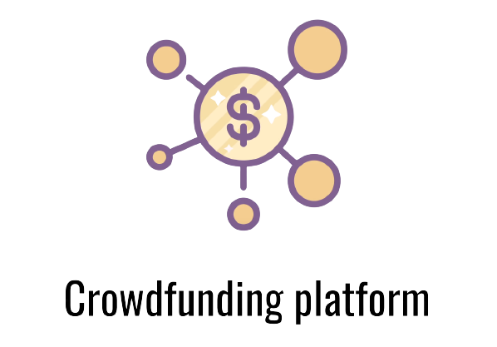
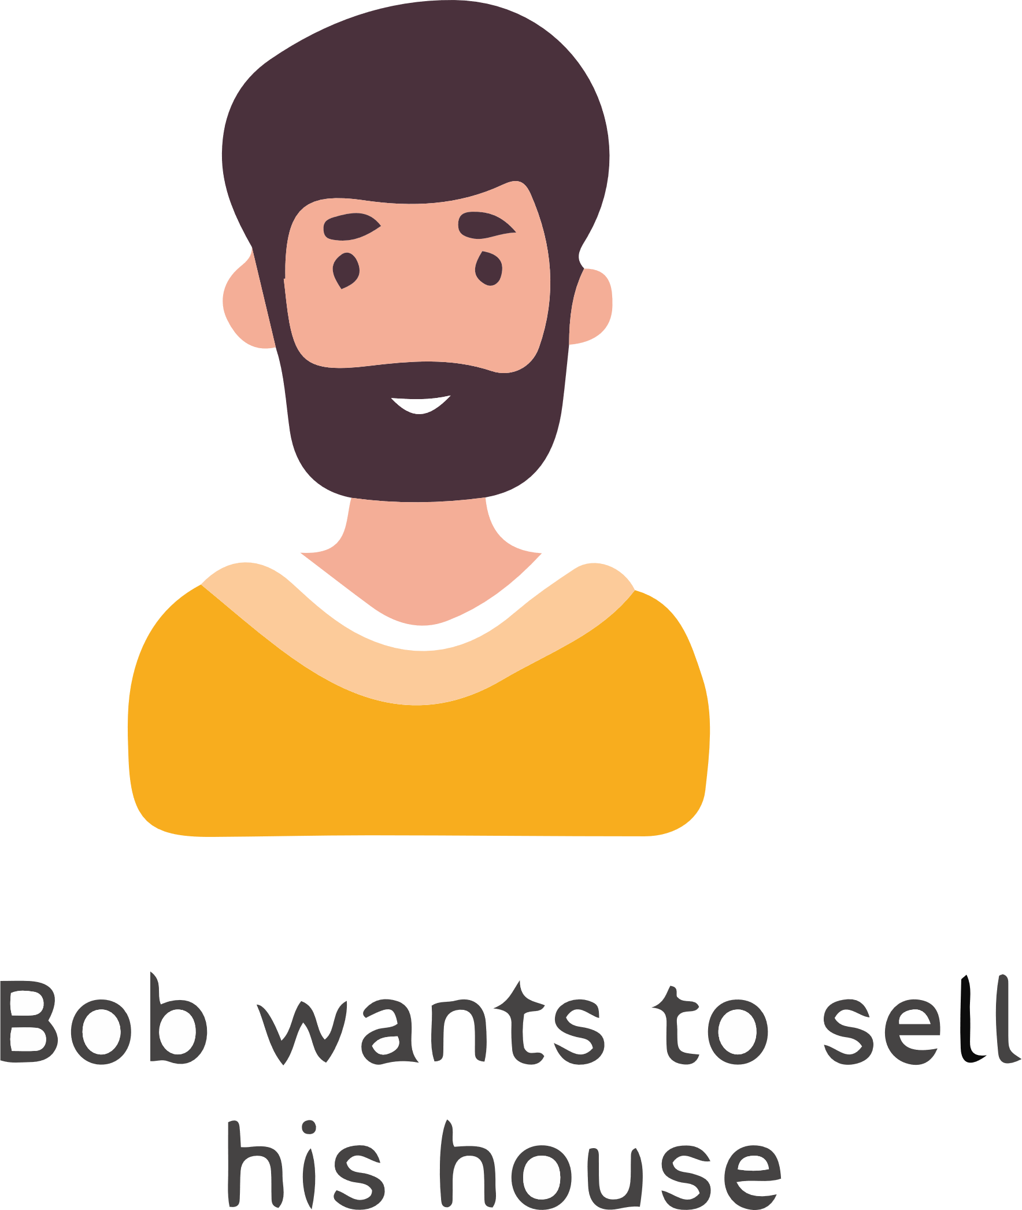
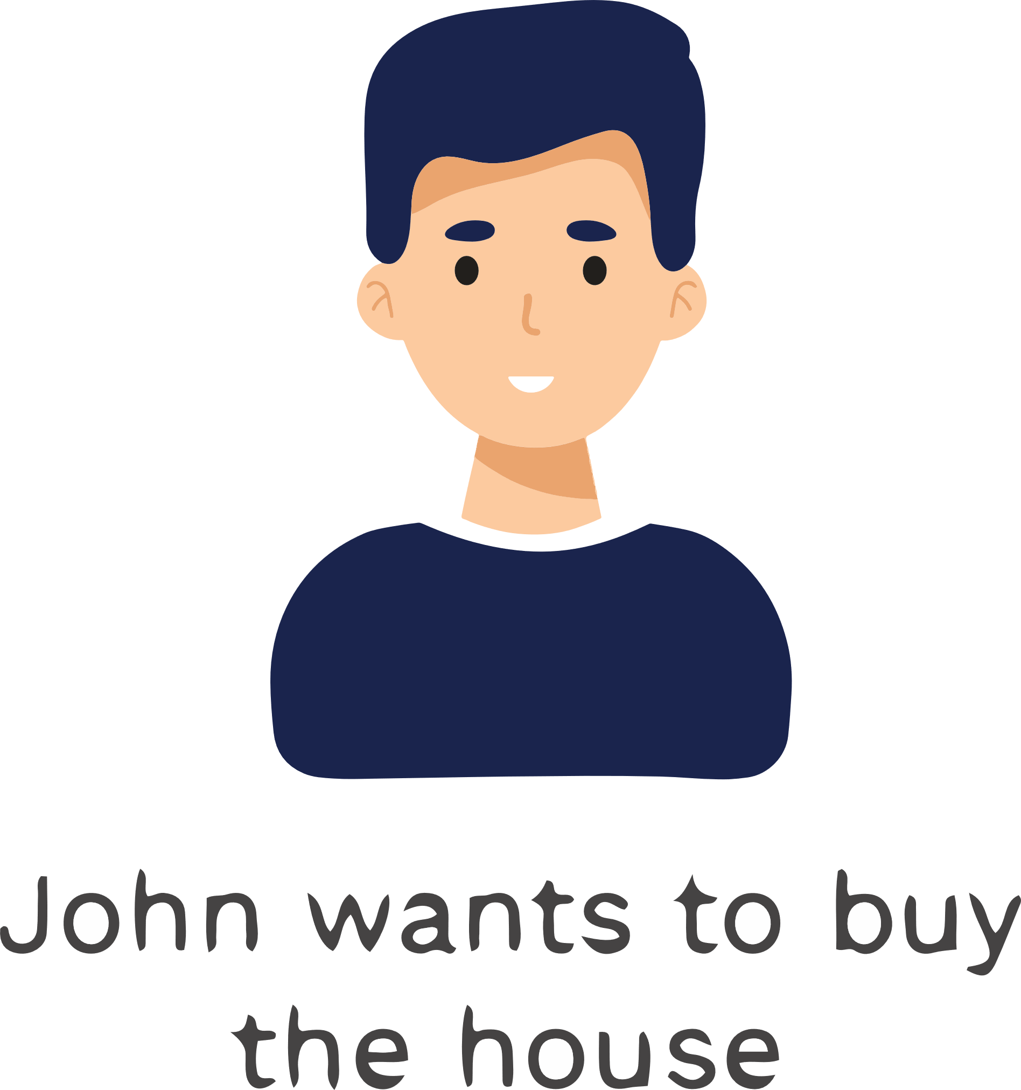


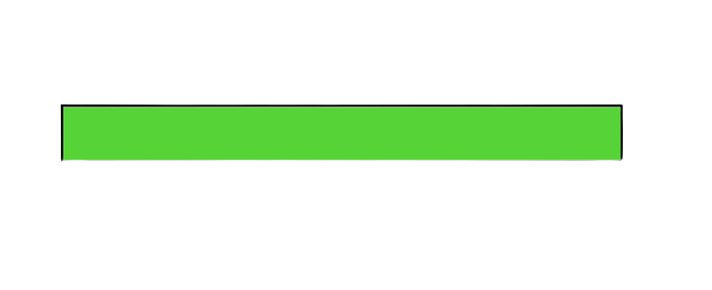
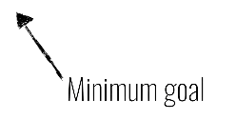
01
Context and Motivations
But what is a Smart Contract?
Let’s first talk about Centralized Systems
Supporters
Product Team
Funded
Notes:
Kickstarted is a 3rd party between supporters and product team!

Slide 8

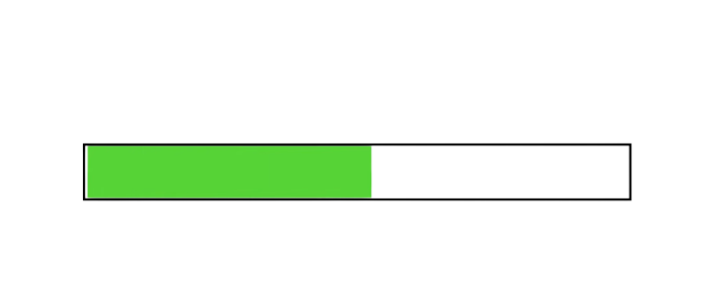
01
Context and Motivations
But what is a Smart Contract?
Funded
Not enough!
I want my money!
Give me my refund!
Trusting Third Party
Notes:
Kickstarted is a 3rd party between supporters and product team!

Slide 9
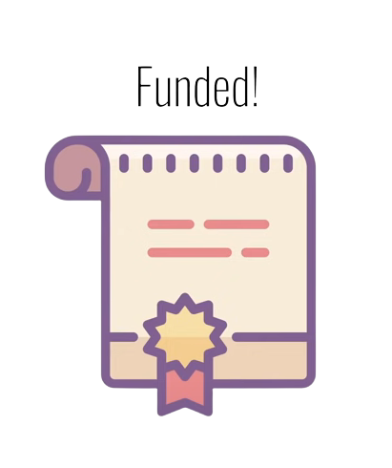
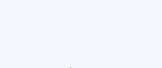
01
Context and Motivations
But what is a Smart Contract?
Moving onward with Decentralized Systems
Funded!

Slide 10
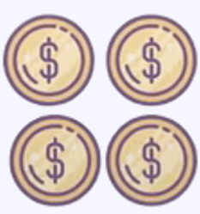

01
Context and Motivations
Failed!
Smart Contracts are Immutable!
Notes:
Smart contracts are immutable!

Slide 11
Problematic
02
Notes:
Time manipulation: If the smart contract relies on time-based conditions, an attacker may attempt to manipulate the contract by exploiting inconsistencies or vulnerabilities related to timekeeping. They could potentially extend or shorten campaign durations, manipulate deadlines, or exploit time-dependent conditions for their own advantage.

Slide 12
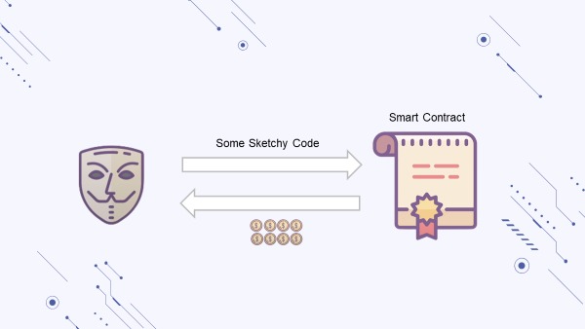
Careless code breeds catastrophes
Notes:
Time manipulation: If the smart contract relies on time-based conditions, an attacker may attempt to manipulate the contract by exploiting inconsistencies or vulnerabilities related to timekeeping. They could potentially extend or shorten campaign durations, manipulate deadlines, or exploit time-dependent conditions for their own advantage.

Slide 13
Related Work
03
Notes:
Time manipulation: If the smart contract relies on time-based conditions, an attacker may attempt to manipulate the contract by exploiting inconsistencies or vulnerabilities related to timekeeping. They could potentially extend or shorten campaign durations, manipulate deadlines, or exploit time-dependent conditions for their own advantage.

Slide 14

03
Related Work
Remix
integrated development environments (IDEs) for Ethereum smart contract development.
Solidity code editor
Compilation and deployment of smart contracts to the Ethereum network
Another valuable feature of Remix is its built-in testing capabilities
Notes:
RemixIDE is a popular integrated development environment for creating, testing, and debugging smart contracts.
One of Remix's testing capabilities is the ability to develop and execute unit tests for smart contracts. This enables developers to test specific functions and methods of their contracts to ensure they are functioning as intended
Remix stands as a versatile and indispensable tool for Ethereum smart contract development.

Slide 15


Framework
Brownie
Truffle
It provides advanced testing capabilities
Truffle is a comprehensive development framework for Ethereum smart contracts and decentralized applications (DApps).
Truffle includes features for compiling, deploying, and migrating smart contracts to various Ethereum networks.
Truffle provides a plugin system that allows developers to extend its functionality and integrate with other tools.
One of its key strengths is its ability to compile, deploy, and interact with smart contracts on the Ethereum network.
Brownie can enhance smart contract testing by generating random or invalid test inputs.
Notes:
"In the realm of Ethereum smart contract development, the Brownie framework stands out as a widely adopted tool. Brownie offers a comprehensive set of features, including contract compilation, deployment, and a testing framework.
*Its integration with custom fuzzing tools or libraries
Truffle :
Truffle is a widely-used development framework for Ethereum smart contracts that provides a comprehensive suite of tools and libraries. It simplifies the process of compiling, deploying, and interacting with smart contracts on the Ethereum blockchain.

Slide 16
Tools | Remix | Brownie
Limits | -Limited Testing Capabilities. -Limited Security Auditing. -Minimal Static Analysis. | - Lack for Interactive Features. -Limited GUI Functionality. -Not specifically designed as a dedicated fuzz testing tool.
Comparison of Remix, Brownie
Notes:
Minimal Static Analysis: Remix offers limited static analysis capabilities. It may not provide extensive warnings or suggestions for potential issues in the contract code. Developers might need to rely on external static analysis tools to complement Remix's analysis capabilities.
Limited IDE Features: Brownie's integrated development environment (IDE) has fewer advanced features compared to dedicated desktop IDEs. It may lack sophisticated code editing functionalities or integrated debugging tools found in specialized IDEs.
Lack of Interactive Features: like visual representations of contract structures, interactive contract editing capabilities, or real-time visual feedback during development. Instead, developers primarily rely on command-line inputs and receive text-based output or logs from the CLI

Slide 17
Proposed Solution
04
Notes:
Time manipulation: If the smart contract relies on time-based conditions, an attacker may attempt to manipulate the contract by exploiting inconsistencies or vulnerabilities related to timekeeping. They could potentially extend or shorten campaign durations, manipulate deadlines, or exploit time-dependent conditions for their own advantage.

Slide 18

LeoKai
Solution Proposed
Notes:
LEOKAI Our app automates smart contract testing using fuzz testing techniques. We use Brownie for developing and testing Ethereum smart contracts, and Flask for creating a user-friendly web interface. We simulate smart contract execution on a Ganache fake network for a controlled testing environment with no real-world costs.

Slide 19
Architechture
05
Notes:
Time manipulation: If the smart contract relies on time-based conditions, an attacker may attempt to manipulate the contract by exploiting inconsistencies or vulnerabilities related to timekeeping. They could potentially extend or shorten campaign durations, manipulate deadlines, or exploit time-dependent conditions for their own advantage.

Slide 20

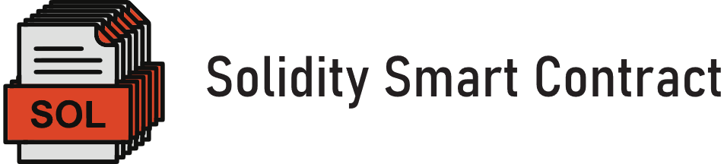

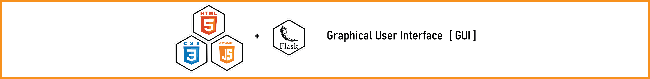



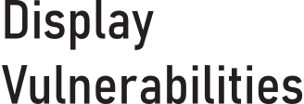
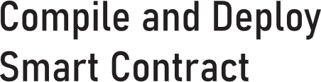
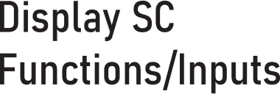
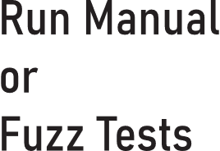

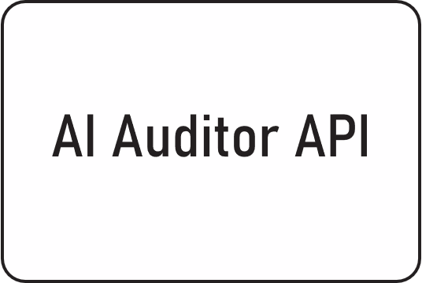
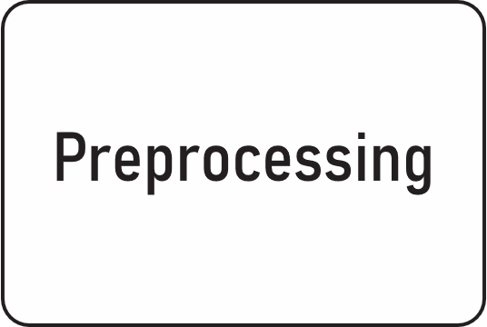

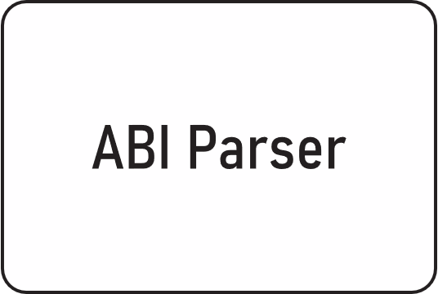
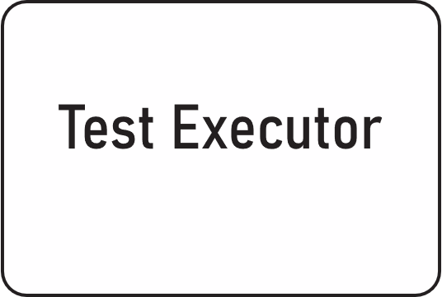

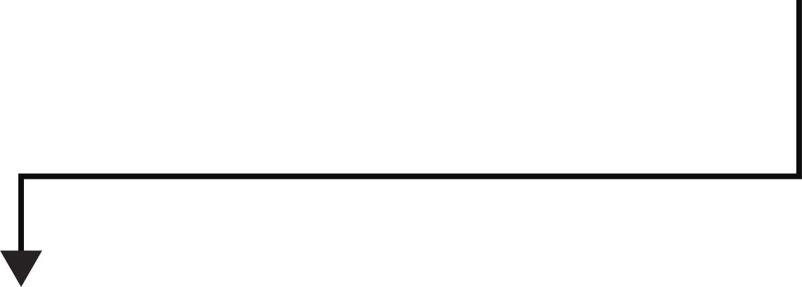
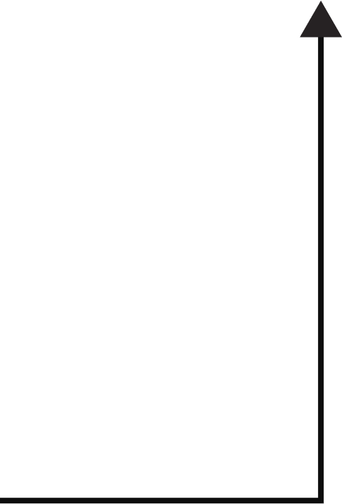
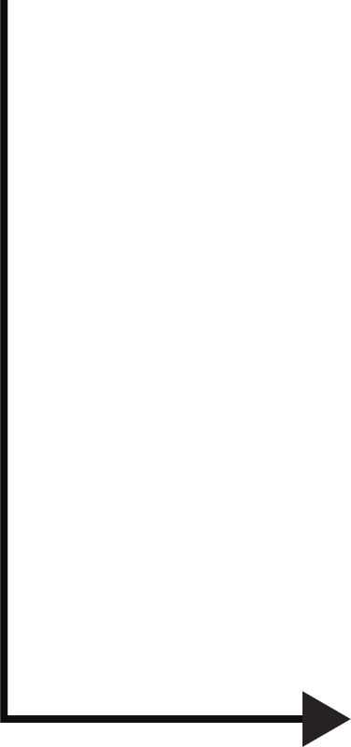
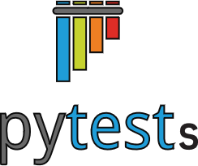
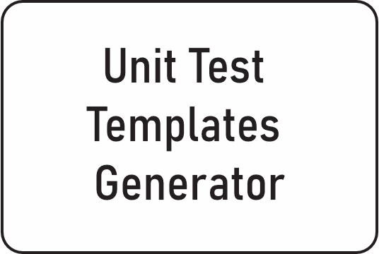
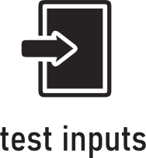
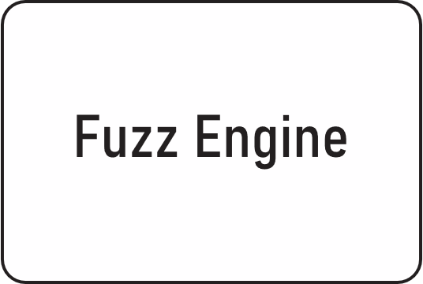
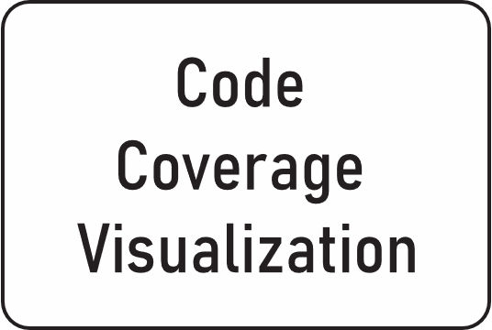



Notes:
Here can gain insight into its architecture and integration with the contract ecosystem.
Our pet's architecture is fragmented into 3 parts the UI/UX the Backend the Blockchain * first of all the GUI has an audit api that will help us estimate and displa vulnerabilities. then we got it linked to a preprocessing phase after compilation and deployment on the ganache blockchain. * this phase will help create a JSON file related to the analysis of our smart contract which will make birth to the abi parsing phase that will help us to both, displaying corresponding sc functions and allowing the use of this JSON object for fuzzing engine. * the fuzz engine will help us create unit tests templates. * the abi parsing phase will also allow us to run manual tests inside the web app * in this stage we will be able to analyse the smart contract coverage thanks to fuzz testing and pytest templates

Slide 21
Conceptual Diagrams
06
Notes:
Time manipulation: If the smart contract relies on time-based conditions, an attacker may attempt to manipulate the contract by exploiting inconsistencies or vulnerabilities related to timekeeping. They could potentially extend or shorten campaign durations, manipulate deadlines, or exploit time-dependent conditions for their own advantage.

Slide 22
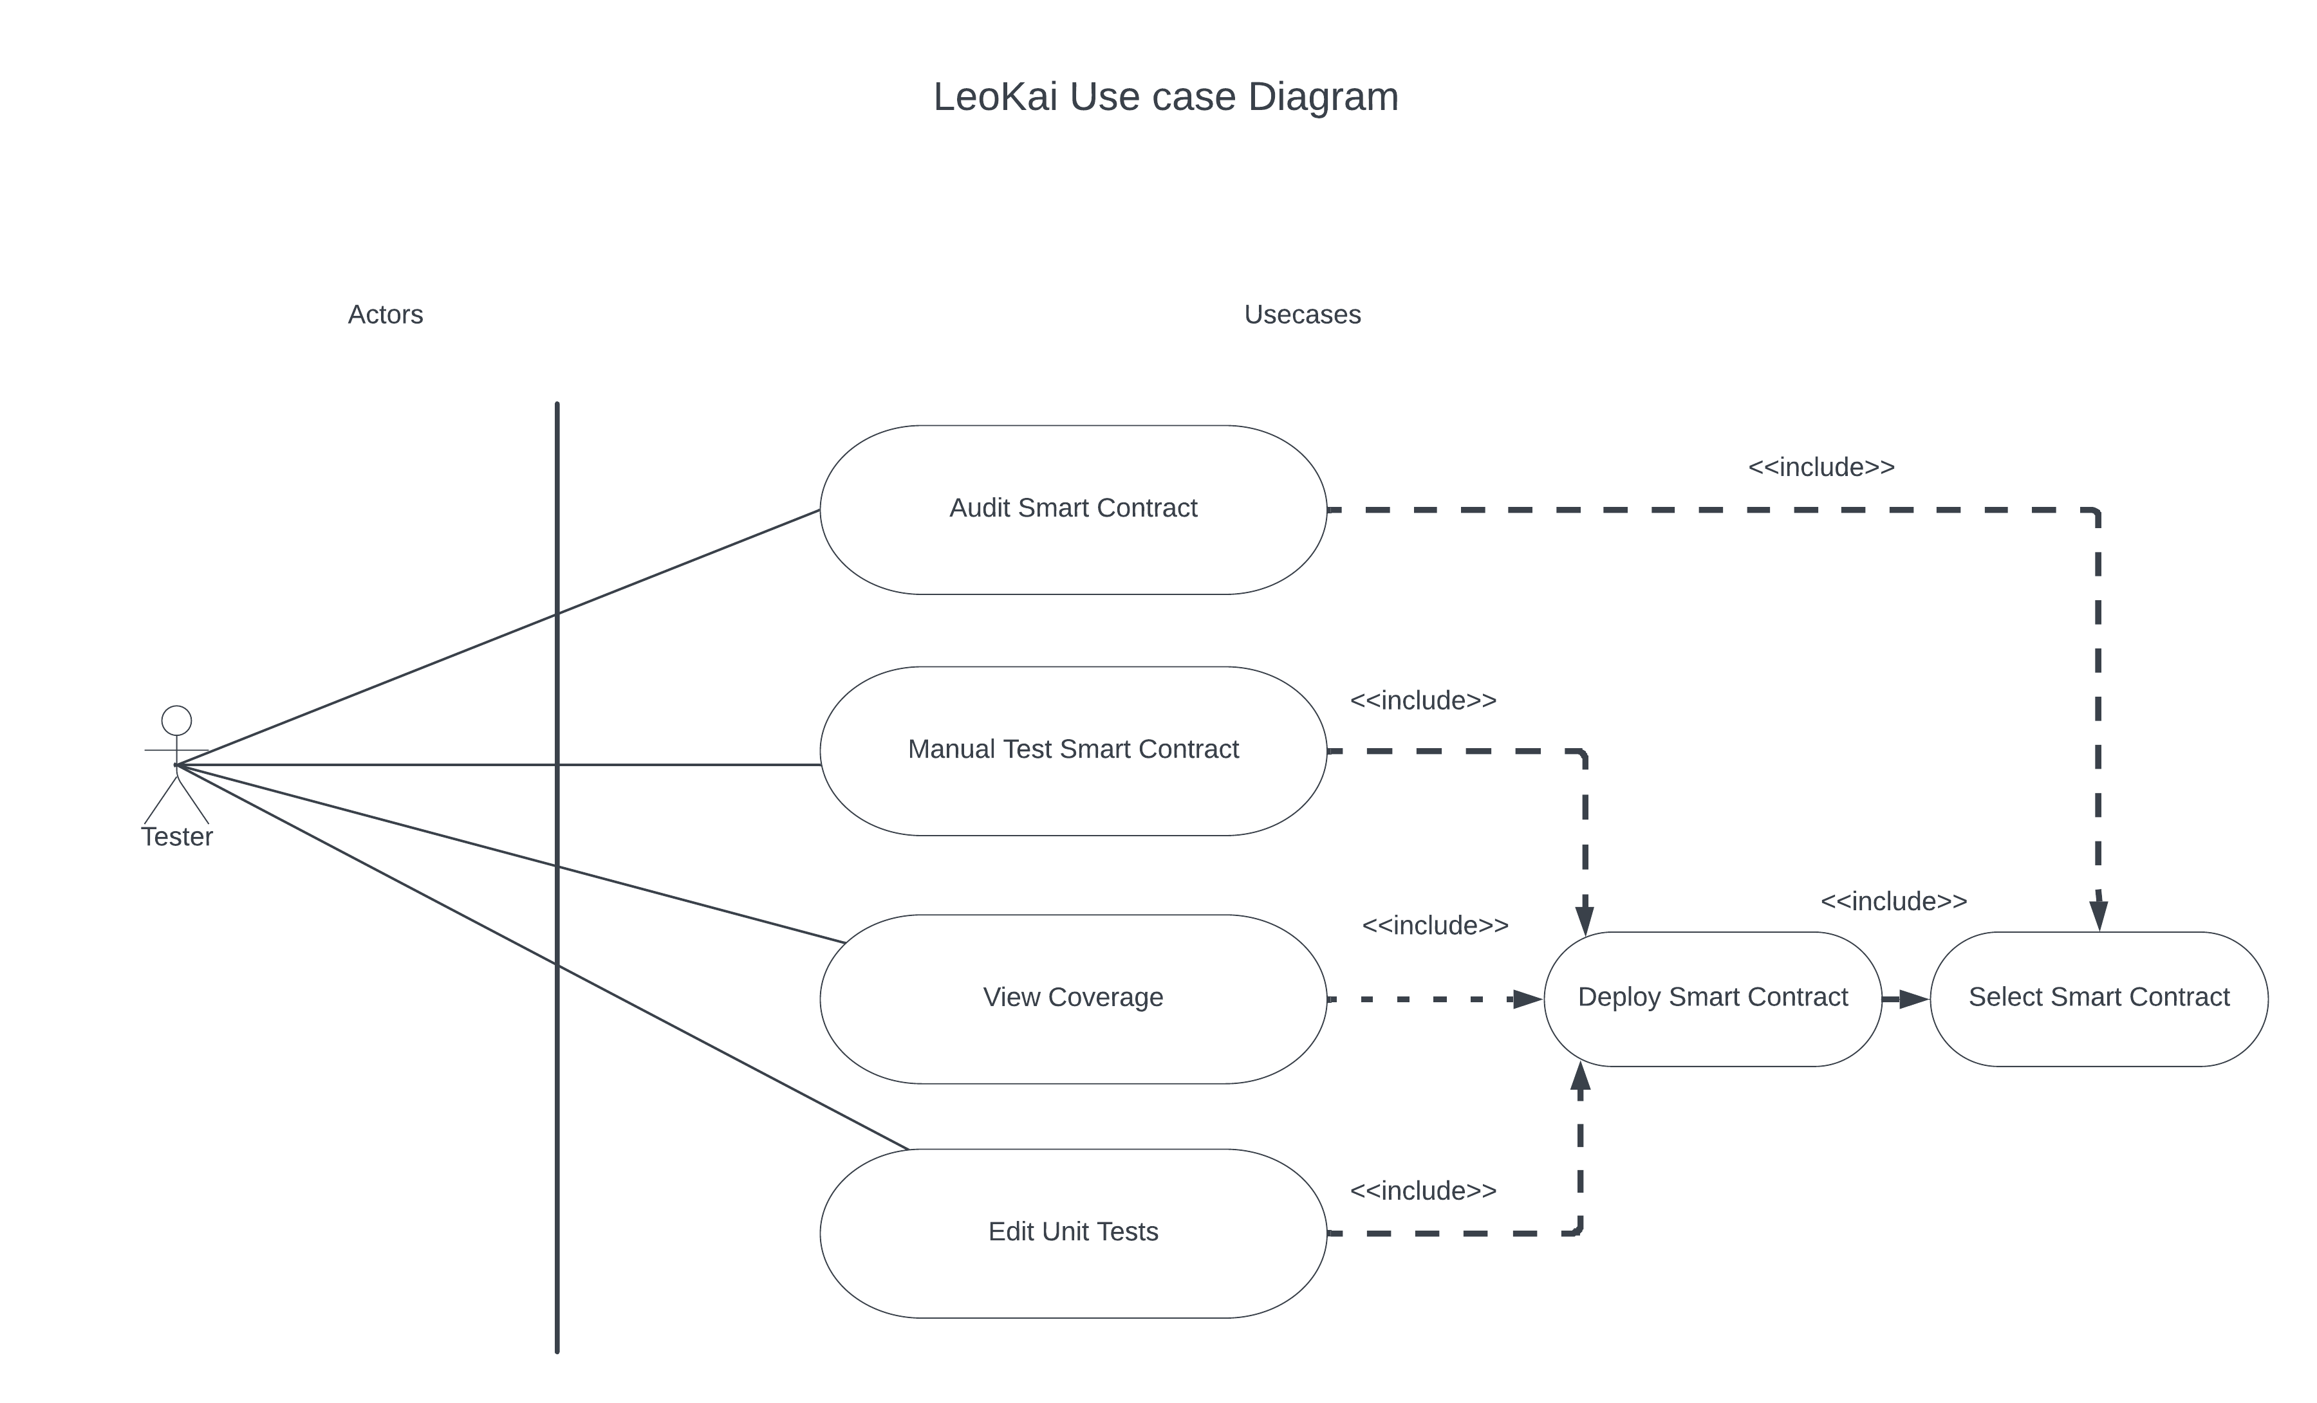

Conceptual
Diagrams

Slide 23

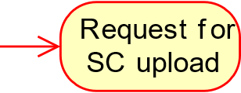
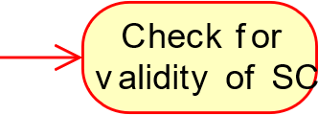
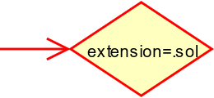
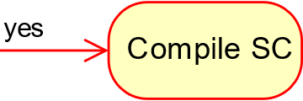
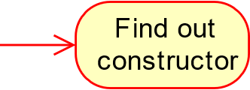
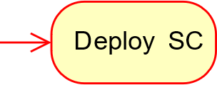
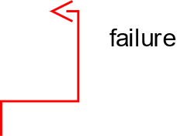
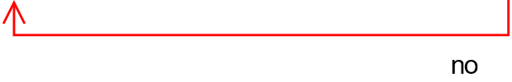
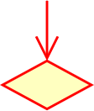
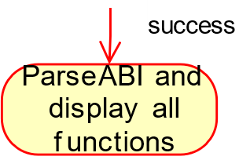
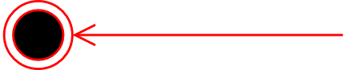
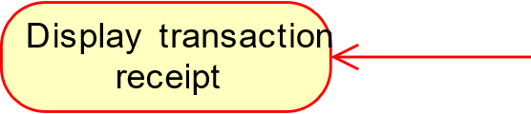
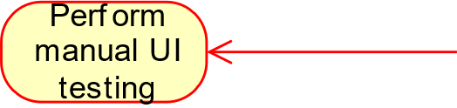







Conceptual Diagrams
LeoKai
LeoKai Activity Diagram

Slide 24









7 Technologies

Slide 25

DEM8

Slide 26

Research Paper
Submitted to ICTSS 2023 Conference (class C)

Slide 27
Insights and Perspectives…

Slide 28
Thank you for your attention!

